Slide 1
Approximation Algorithms

Slide 2
Introduction
Approximation algorithms are used to get a solution close to the (optimal) solution of an optimization problem in polynomial time
For example, Traveling Salesman Problem (TSP) is an optimization problem (the route taken has to have minimum cost).
Since TSP is NP-Complete, approximation algorithms allow for getting a solution close to the solution of an NP problem in polynomial time.

Slide 3
Definition
An algorithm is an α-approximation algorithm for an optimization problem Π if
The algorithm runs in polynomial time
The algorithm always produces a solution that is within a factor of α of the optimal solution
Minimization – α < 1
Maximization – α > 1

Slide 4
Set Cover (SC)
A set cover of a set T is any collection of subsets of T whose union is T.
The set cover problem: given a weight for each subset, find the set cover which minimizes the total weight

Slide 5
Example of Set Cover
Set T = { 1, 2, 3, 4, 5, 6, 7, 8 }
Available subsets:
S1 = { 1, 2, 3 } w1 = 1
S2 = { 2, 7, 8 } w2 = 2
S3 = { 4, 5, 6, 7 } w3 = 3
S4 = { 4, 5, 6, 8 } w4 = 4
Solutions: C = { S1, S2, S3 }, C = { S1, S2, S4 }
Optimal Solution is C = { S1, S2, S3 }

Slide 6
Weighted Vertex Cover (WVC)
Here, we try to find a collection of vertices of a graph such that each edge of the graph contains at least one vertex from the collection
Each vertex has a weight and we try to find the collection that minimizes the total weight

Slide 7
Example of Vertex Cover
Possible Solutions are:
{ 1, 3, 4 }
{ 1, 7, 5 }
If the weights are the vertex numbers, then the optimal solution is: {1, 3, 4}
The Graph
1
2
7
3
6
4
5

Slide 8
Vertex Cover as Set Cover
Vertex Cover is a special case of Set Cover
To convert a problem from vertex cover to set cover:
Make T = the set of edges E
Make the subsets correspond to each vertex, with each subset containing the set of edges that touch the corresponding vertex

Slide 9
Example of VC as SC
T = { (1, 3), (3,7), (1, 7), (4, 5), (4, 6) }
Subsets:
S1 = { (1, 3), (1, 7) } w = 1
S3 = { (1, 3), (3, 7) } w = 3
S7 = { (1, 7), (3, 7) } w = 7
S4 = { (4, 5), (4, 6) } w = 4
S6 = { (4, 6) } w = 6
S5 = { (4, 5) } w = 5
The Graph
1
2
7
3
6
4
5

Slide 10
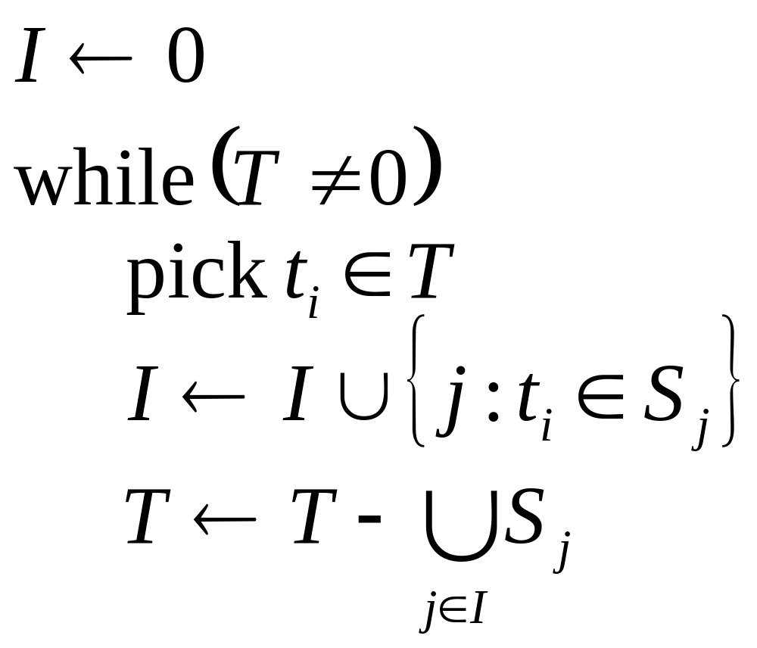
Algorithm for Unweighted Set Cover

Slide 11
Proof of Algorithm
Elements are deleted from T only when they are covered, and we delete at least one each time in the loop, at the end of which, no elements are left in T.
Therefore, the algorithm returns a set cover.

Slide 12
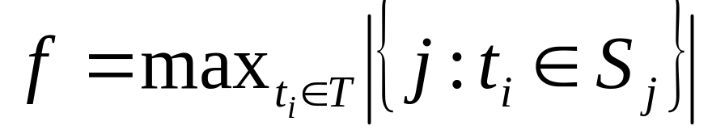
Definition of f
Define
In other words, f is the number of subsets in the set cover that cover that element that is in the most subsets in the set cover
For VC problem, f = 2 because each element in the set is covered always by 2 subsets (representing the two endpoints of the edge).

Slide 13
Algorithm is f-approximation (1)
The Algorithm runs in polynomial time
During each iteration of the loop, a t_{i} chosen is covered by at least one distinct subset that is in the optimal solution.
This can be shown by contradiction: If there was a t_{k} chosen in a later iteration that is also in that same S_{j} then it would have to remain in T after we chose t_{j}. But when t_{j} was chosen all sets that contain it were chosen too and all their elements were removed from T including t_{k}.

Slide 14
Algorithm is f-approximation (2)
Therefore, if there are n iterations through the loop, n is less or equal to the number of sets in the optimal solution (OPT).
Each iteration in the loop we pick at most f sets to add to I.
Therefore, |I| ≤ f * n ≤ f * OPT.
Therefore, the algorithm is an f-approximation.
However, this algorithm is not designed to solve the weighted problem, which is what we wish to solve.

Slide 15
Linear Programming (LP)
Linear programming is the problem of optimizing a linear function subject to linear inequality constraints.
The function being optimized is called the objective function.
The function with the constraints is called the Linear Program.
Any assignment of variables that satisfies the constraints is called a feasible solution.

Slide 16
An example of LP
Minimize 7x₁ + x₂ + 5x₃
Constraints:
    x₁ - x₂ + 3x₃ ≥ 10
    5x₁ + 2x₂ - x₃ ≥ 6
    x₁ ≥ 0
    x₂ ≥ 0
    x₃ ≥ 0

Slide 17
Standard Form of LP
All constraints are of type greater or equal in minimization LP, and less or equal in maximization LP.
All variables are constrained to be non negative.
By a simple transformation any linear program can be written as a standard minimization or maximization LP.

Slide 18
Upper Bound for Minimization
Any upper bound (for the minimization) can be checked by simply finding a solution that satisfies the equation in less than the upper bound.
(2, 1, 3) is such an example for upper bound 30.

Slide 19
Lower Bound for Minimization
To find a lower bound, we can note that 7x₁ + x₂ + 5x₃ ≥ x₁ - x₂ + 3x₃ ≥ 10, because all coefficients are greater than the corresponding coefficients and all variables are non-negative.
An even better lower bound can be obtained by doing: 7x₁ + x₂ + 5x₃ ≥ (x₁ - x₂ + 3x₃) + (5x₁ + 2x₂ - x₃) ≥ 16

Slide 20
Maximizing Lower Bound
The minimum solution of the objective function will be obtained when we find the maximum lower bound for the function.
Particularly, it can be formulated as a linear program:

Slide 21
Maximization LP of Lower Bound
Maximize 10y₁ + 6y₂
Constraints:
    y₁ + y₂ ≤ 7
    -y₁ + 2y₂ ≤ 1
    3y₁ - y₂ ≤ 5
    y₁ ≥ 0
    y₂ ≥ 0

Slide 22
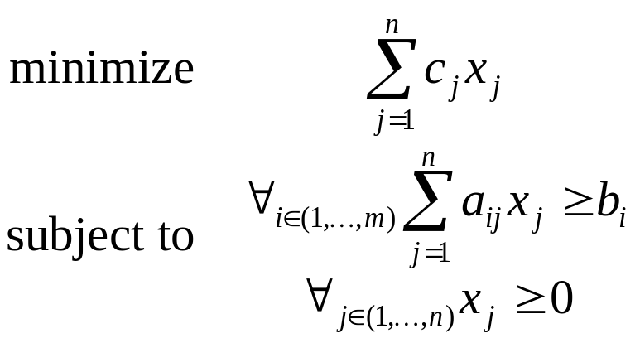
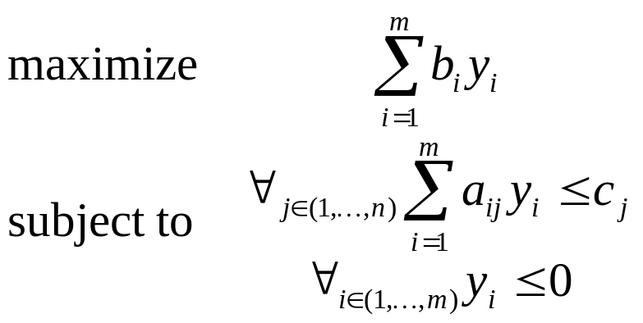
Min-Max (Primal-Dual) Equivalency
Primal Problem
Dual Problem

Slide 23
Relation between the Min/Max LPs
The first LP will be called the Primal Program and the second LP will be called the Dual Program.
There is a systematic way of finding the Dual of any Primal. Furthermore, the Dual of the Dual of X is X itself.
By construction, every feasible solution to the dual gives a lower bound on the optimum of the primal.
Also, every feasible solution to the primal gives an upper bound on the optimum of the dual.

Slide 24
LP-Duality (1)
Furthermore, if the primal solution is equal to the dual solution (say, some value, x) then that means:
  x is a lower bound on optimum of primal
  x is an upper bound on optimum of dual
  If the optimum of the dual was lower than x, then that optimum is a feasible solution which means that optimum is a lower bound on the primal (and is less than x). This is a contradiction.
  Similarly, by contradiction, the optimum of the primal can’t be larger than x.
  In other words, x is the optimal solution in this case.

Slide 25
LP-Duality (2)
This is a central theorem of Linear Programming called the LP-Duality Theorem.
In fact, not only will this happen if the optimum of the dual is equal to that of the primal but if there is a solution, then it will be equal to both functions.

Slide 26
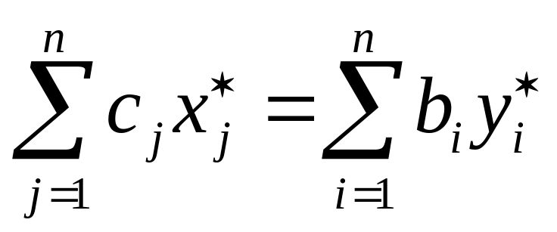
LP-Duality Theorem
Refer to Primal-Dual Equivalency Definitions
The primal program has finite optimum iff the dual has finite optimum. Moreover, if x* and y* are optimal solutions for the primal and dual respectively, then

Slide 27
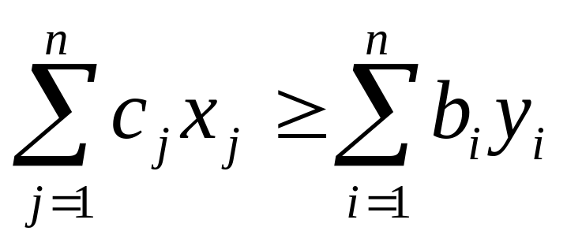
Weak Duality Theorem
If x is a feasible solution for the primal and y is a feasible solution for the dual, then

Slide 28
Integer Programming (IP)
Integer Programming is simply Linear Programming with an added condition:
  All variables must be integers
Many problems can be stated as Integer Programs.
For example, the Set Cover problem can be stated as an integer program.

Slide 29
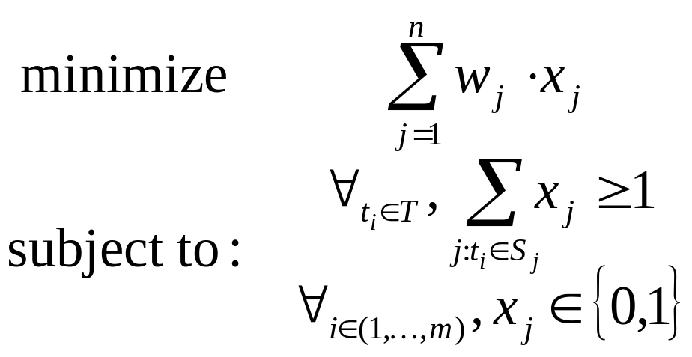
Weighted Set Cover (WSC) as IP
For each subset we will give an integer variable, 0 or 1, that is 1 if the subset is part of the cover, and 0 if not.
Then we can state the weighted set cover as:

Slide 30
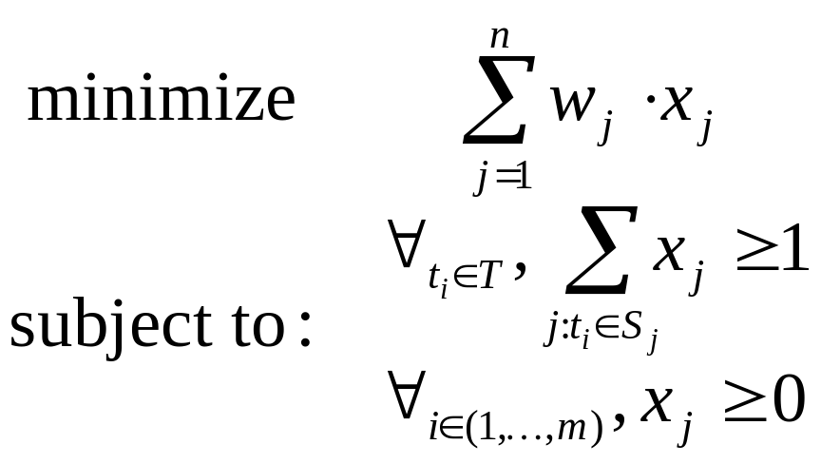
Relaxed LP for WSC
We can write the IP to the WSC in a more relaxed form:
Now, if Z_{LP} is the optimum of this LP, then Z_{LP} ≤ OPT, because any feasible solution for the IP is also feasible for the LP. So the optimal LP will not be greater than the optimal IP.

Slide 31
Using Relaxed LP as Approximation
Given the LP, the optimum is Z_{LP}.
If there is a solution of cost no more than α• Z_{LP}, then the cost is no more than α• OPT.
Therefore, if the LP is solved for a feasible solution in polynomial time that is α times the optimum LP value, then that is also an α-approximation of the IP, and corresponding Set Cover problem.

Slide 32
Basic Technique
Write the IP describing the problem.
Relax the IP to get an LP.
Find the optimal solution to the LP.
Find integral values for the (linear) variables such that the solution is at most α of the optimal solution to the IP.
Reformulate the integral values as solution to the problem.

Slide 33
Overview of Basic Technique
Steps 1 and 2 can be performed in polynomial time, easily.
Step 5 can also be performed in polynomial time.
Step 3 can be done in polynomial time too, but sometimes it’s easier to connect it to step 4.
The tricky part is really step 4, and four ways will be shown to accomplish it.
The methods shown will solve the Set Cover, in particular, but can be used for any IP.

Slide 34
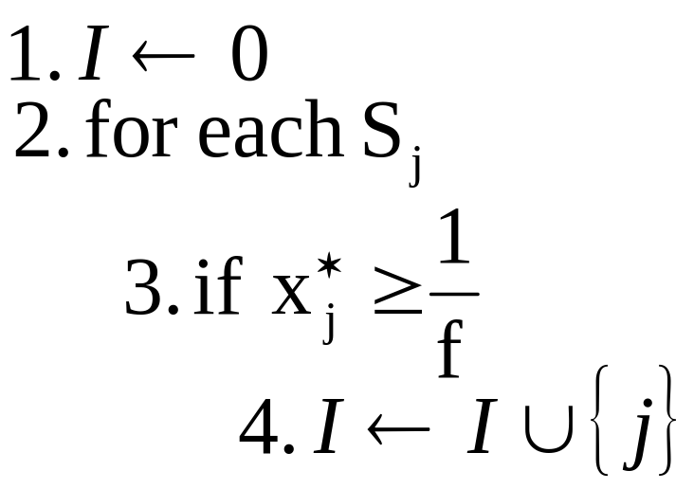
Method 1: Rounding
This implements step 4 only:

Slide 35

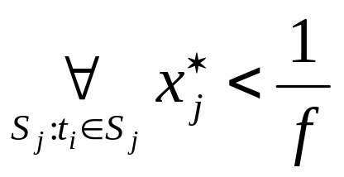
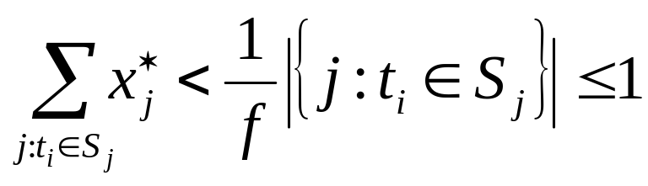
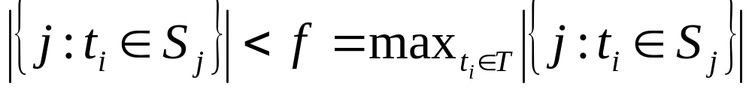
Proof: Rounding Method Produces Set Cover
Assume by contradiction that there is an element t_{i} such that
Then,
And therefore:
Since,
But this violates the LP constraints.

Slide 36
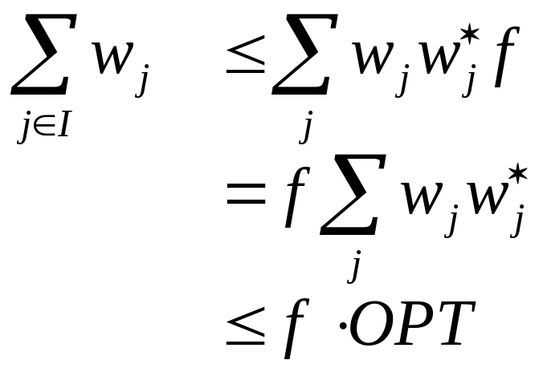
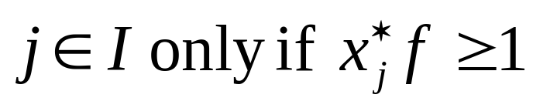
Proof: Rounding is f-approximation Algorithm
The algorithm is a polynomial time algorithm for step 4 in the Basic Technique.
Furthermore,
The first inequality holds, since

Slide 37
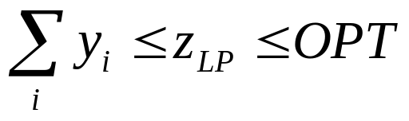
Method 2: Dual-LP
This second method is based on the dual solution.
By weak duality, if there is a feasible solution y, then

Slide 38
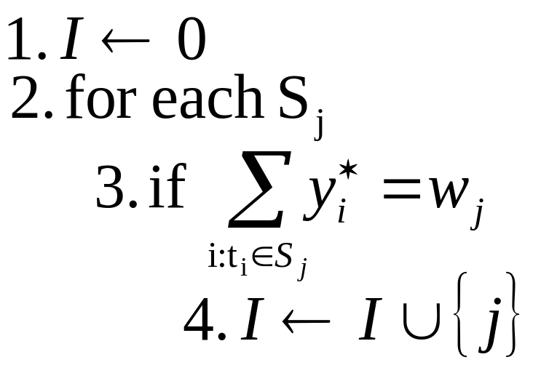
Dual LP-Algorithm
First, solve the dual linear program to get an optimal solution y*
Then, apply the following algorithm:

Slide 39
Proof: Dual-LP Produces Set Cover
Assume by contradiction that there is an element t_{i} that is not part of the final result.
In that case,

Slide 40

Method 3: Primal-Dual

Slide 41
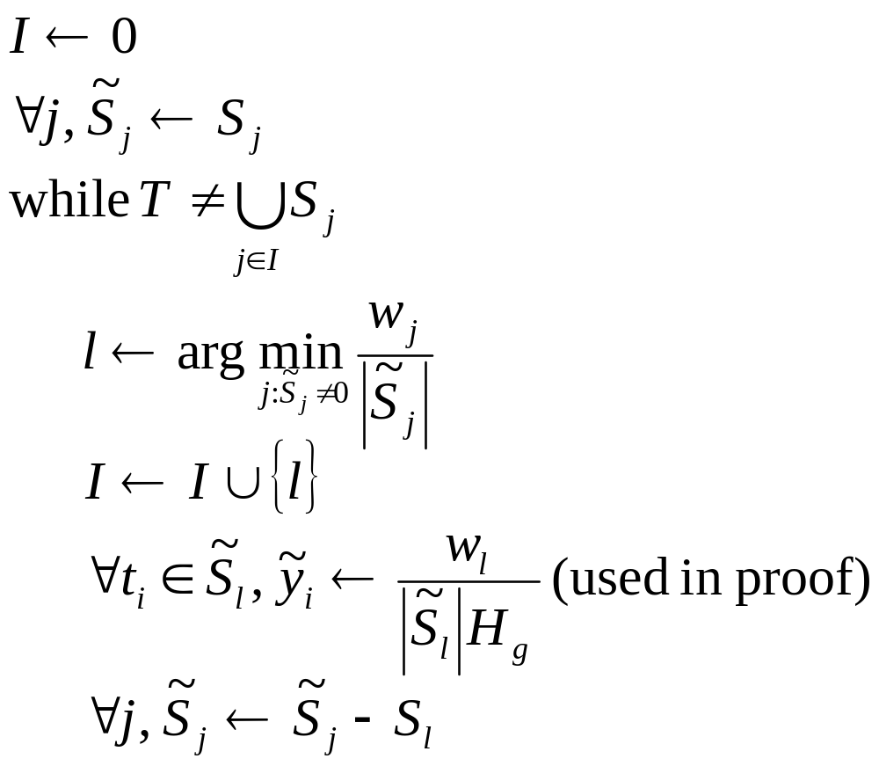
Method 4: Greedy Algorithm

Slide 42
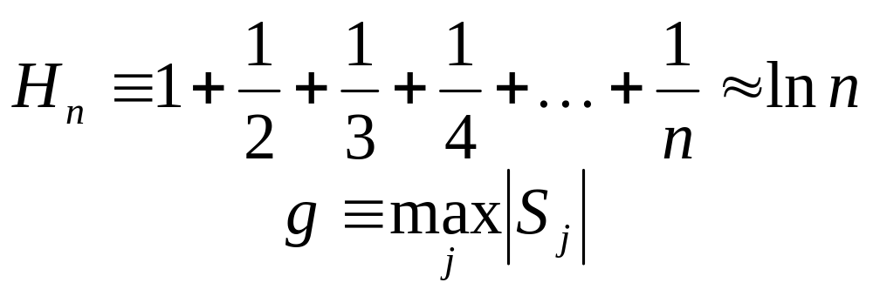
Greedy Algorithm
Define

